Slide 1
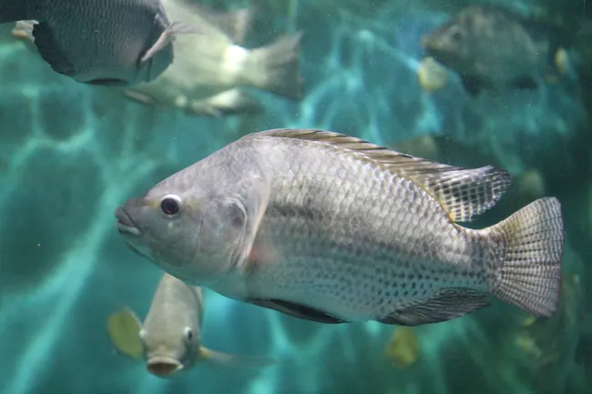
Nile Tilapia: Retina Gene Expression
Group 2 Oophaga: Expression between Developmental Stages

Slide 2
01
Introduction
Background, Research Question

Slide 3
Background: Nile Tilapia Developmental Shift in Photokinesis
Nile Tilapia exhibit phototaxis behavior in the form of kinesis
Developmental switch in phototaxis
12 days post fertilization (dpf): Increased kinesis in light
17 dpf: Increased kinesis in darkness
Underlying genetic basis of shift?
Differential retina gene expression between developmental stages/age
Data Collected
Our samples include fish offspring from one father and 2 mothers—one with red (R) and one with blue (B) markings.
3’Tag-seq sequencing data from RNA extracted from 12 dpf and 17 dpf fish samples

Slide 4
How do expression values change across developmental stages?
How does retina gene expression change between 12 days post fertilization (dph) and 17 days post fertilization (dph)?
Do maternal factors play a role in retina gene expression?
Motivation: By studying how retina gene expression for phototaxis varies, we can gain insight into the development of visual systems for aquatic organisms and other species that exhibit phototaxis behavior.

Slide 5
Analysis Method
Clean datasets for Analysis
Normalized raw retina read counts using TPM
Log normalization, removing 0’s & infinite values
Ran and Visualize PCA
Explore sources of variation
ANOVA
Further PCA
DEseq2

Slide 6
02
Part 1:
How does retina gene expression change between 12 days post fertilization (dph) and 17 days post fertilization (dph)?

Slide 7
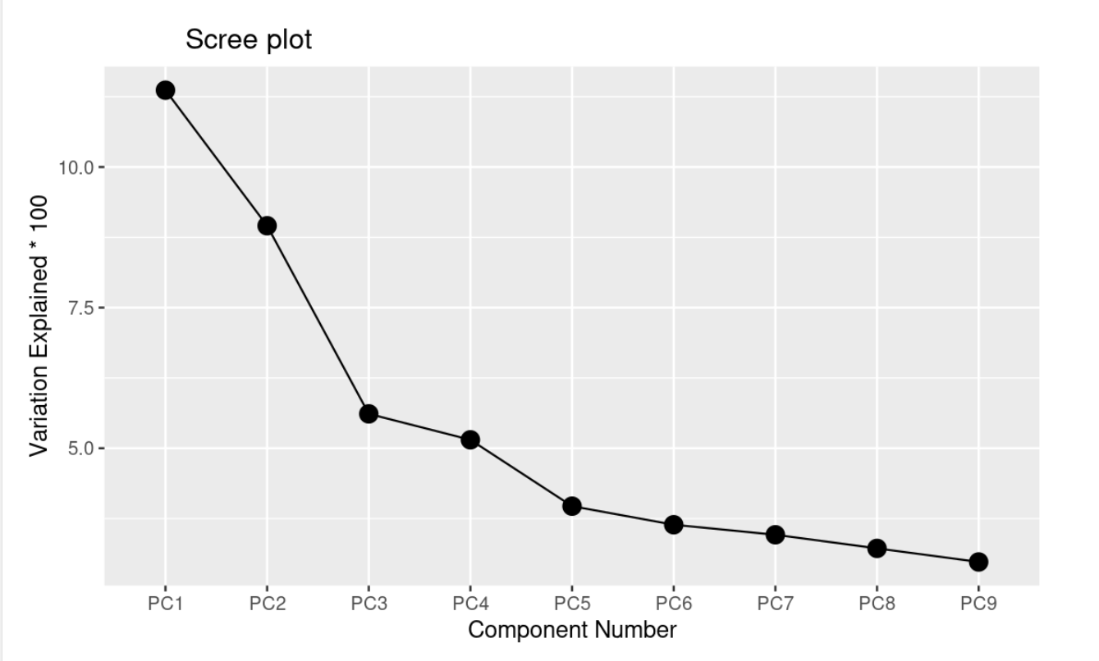
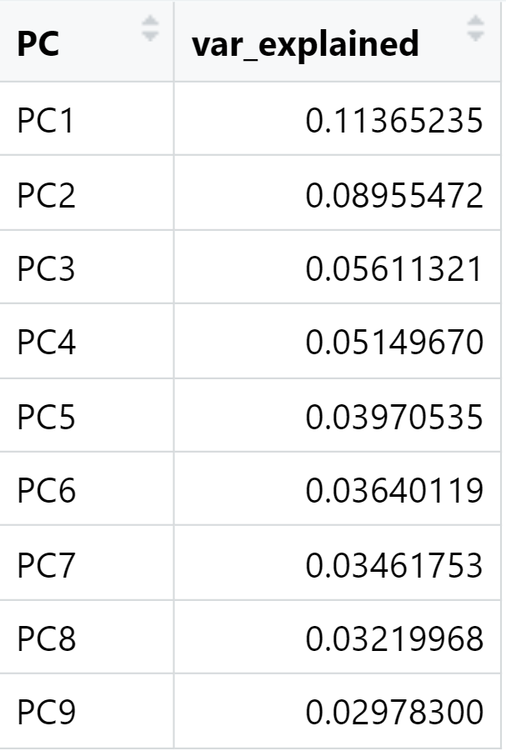
Phototaxis Variation Explained by PCA components

Slide 8
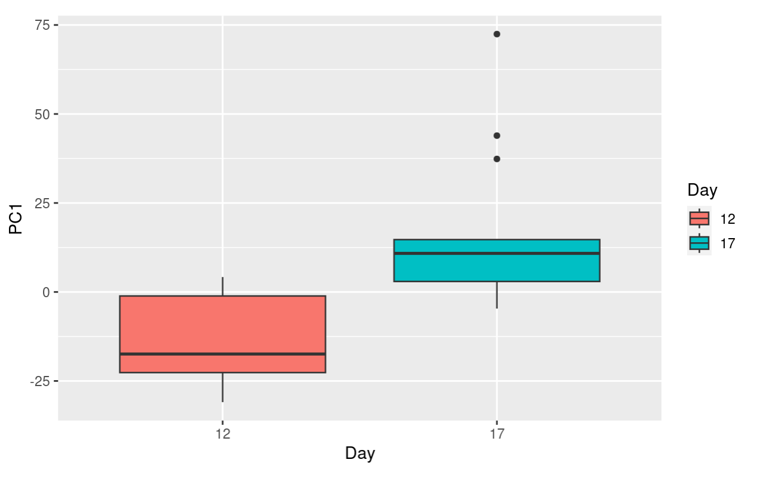
PC1 Score Boxplot by Day
Feature Chosen by PC1:
Day accounts for ~11% of the total variation of the samples
Analysis
More Variation in Day 12 than 17
More Outliers in Day 17
Further Questions
Why does the day account for such a small amount of the variation?
Notes:
Positive scores along PC1 indicate data points that have higher-than-average values for the features that contribute positively to PC1 and/or lower-than-average values for the features that contribute negatively to PC1.
Negative scores along PC1 indicate data points that have lower-than-average values for the features that contribute positively to PC1 and/or higher-than-average values for the features that contribute negatively to PC1.

Slide 9
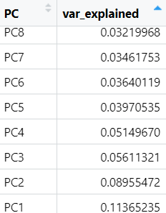
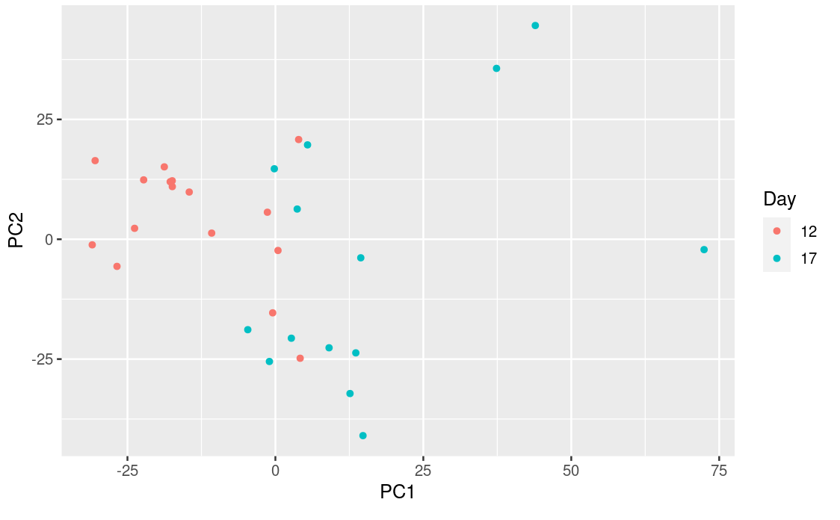

Slide 10
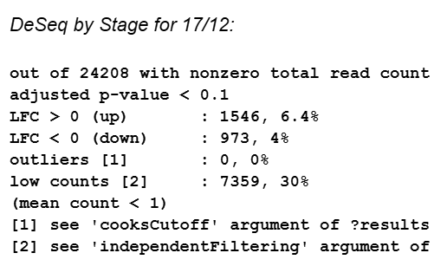
Significance: Day17>Day12

Slide 11
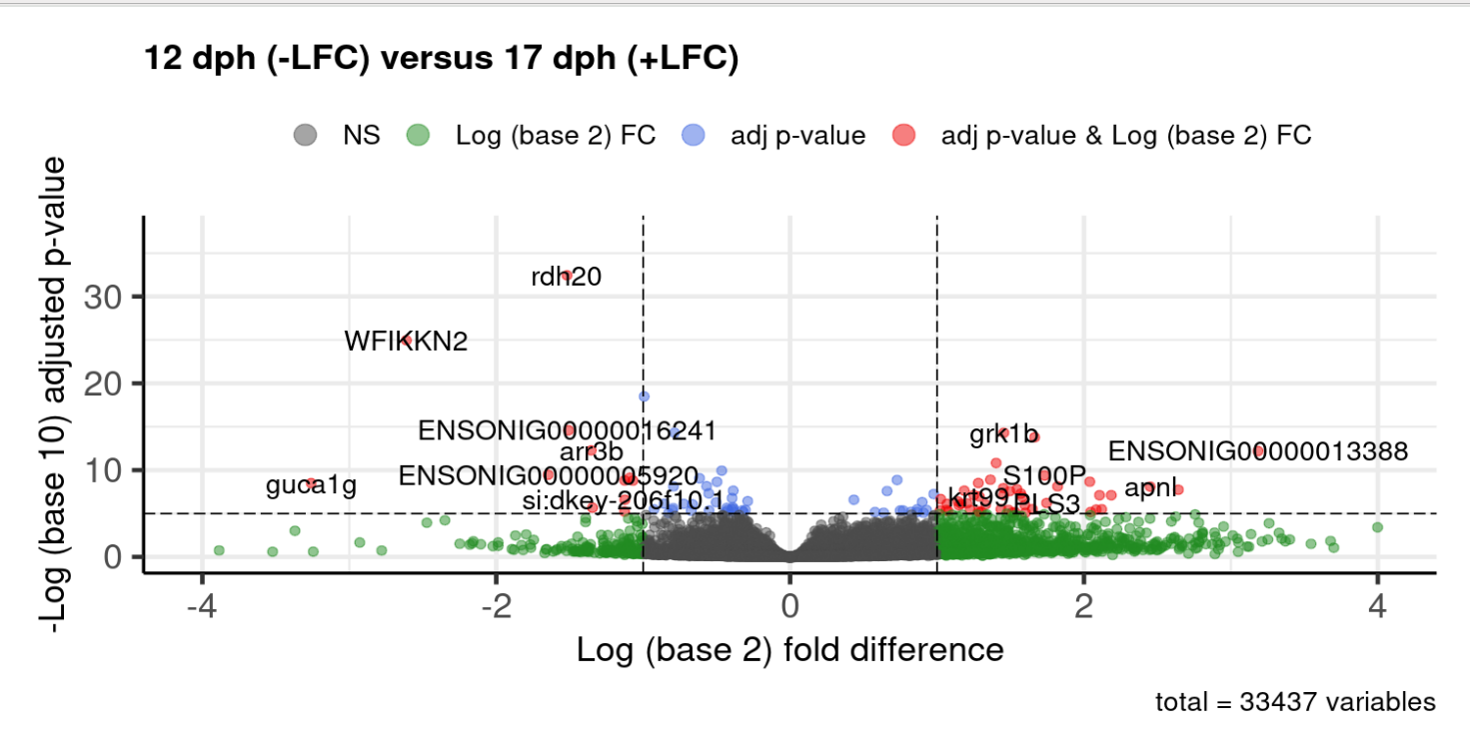
Day 17 more differentially expressed than Day 12
Reason Guess:
Biological processes more actively
Certain cellular processes responses might undergo significant changes later
Significant genes
Rdh20: protein_coding_gene
Taxon: Danio rerio(tropical fish)
WFIKKN2: human protein
Taxon: Pan troglodytes
Notes:
Thresholds: Researchers usually set thresholds for both fold change and statistical significance to identify the most meaningful differences. These thresholds depend on the specific experiment and are often determined based on biological significance and statistical power.
Highlighted points: Points that fall above the significance threshold (usually towards the top of the volcano plot) and far from the center (indicating a large effect size) are typically considered the most biologically relevant. These points represent genes or other features that are significantly differentially expressed between the compared conditions.
Biological Processes:
Biological processes occurring on Day 17 may be more dynamic or actively regulated compared to Day 12. Certain cellular processes, pathways, or responses might be more pronounced or undergo significant changes at the later time point.
For example, if your experiment involves a developmental process, certain genes may be upregulated or downregulated more prominently as cells differentiate or respond to external stimuli over time.

Slide 12
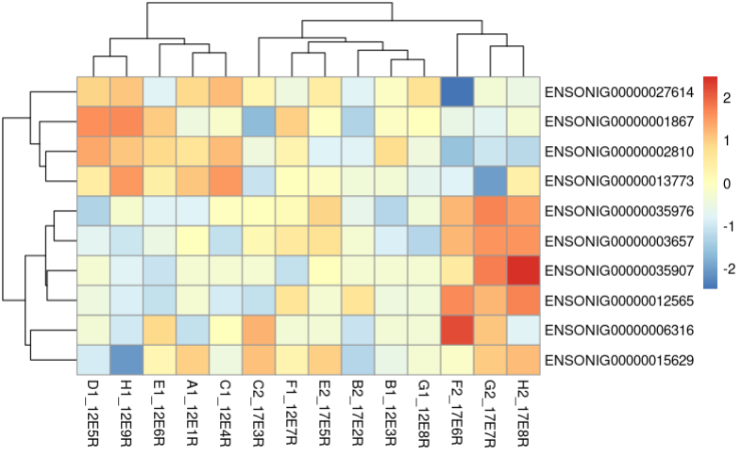
Day 17 more significant than Day 12
Analysis:
Patterns and Clusters
Taxon: Danio rerio
(jph1b&mfge8b)
Pan troglodytes
(cmpk2)
Intensity of Color
Prediction:
regulatory mechanisms?
environmental cues?
cellular responses?
Sample distribution?
cmpk2
Jph1b
mfge8b
Notes:
<-1 | log2FoldChange > 1 ) & (padj < 0.05) log_tpms_outlierRemove
Intensity of Color: (i.e., gene expression levels) across samples. Look for any trends or correlations in their expression patterns that may indicate regulatory mechanisms or cellular responses to environmental cues.
Patterns and Clusters: Visualize the clustering results using heat maps or dendrogram plots to identify patterns of gene expression across different conditions or developmental stages.
Biological Interpretation:
may play a more significant role or be more actively involved in the biological processes or pathways relevant to Day 12 compared to Day 17. This could be due to various factors such as regulatory mechanisms, environmental cues, or cellular responses.

Slide 13
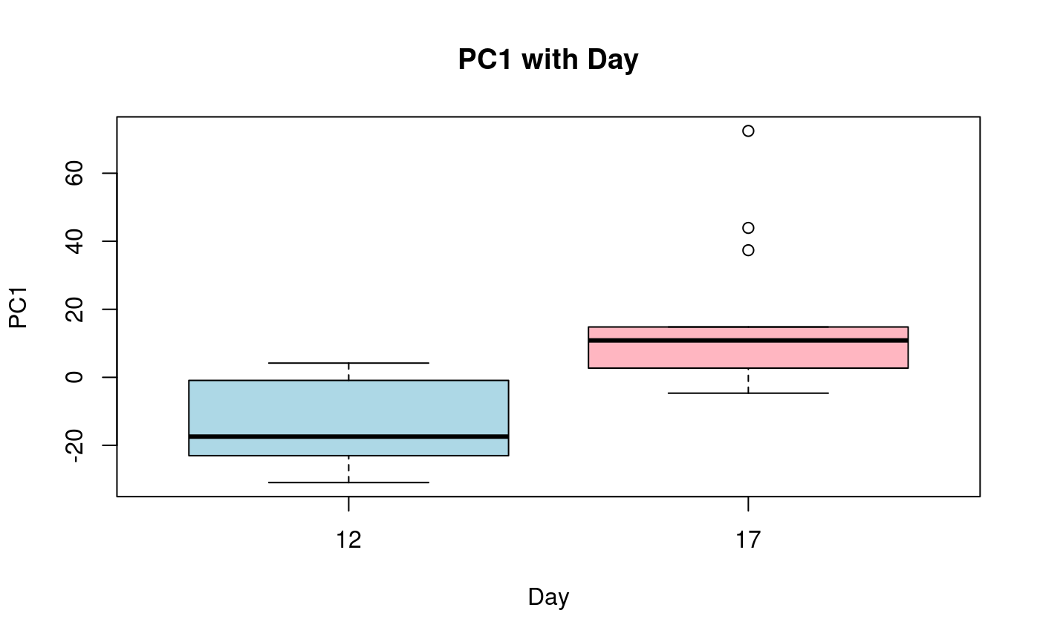

Slide 14
03
Part 2:
Do maternal factors play a role in retina gene expression?

Slide 15
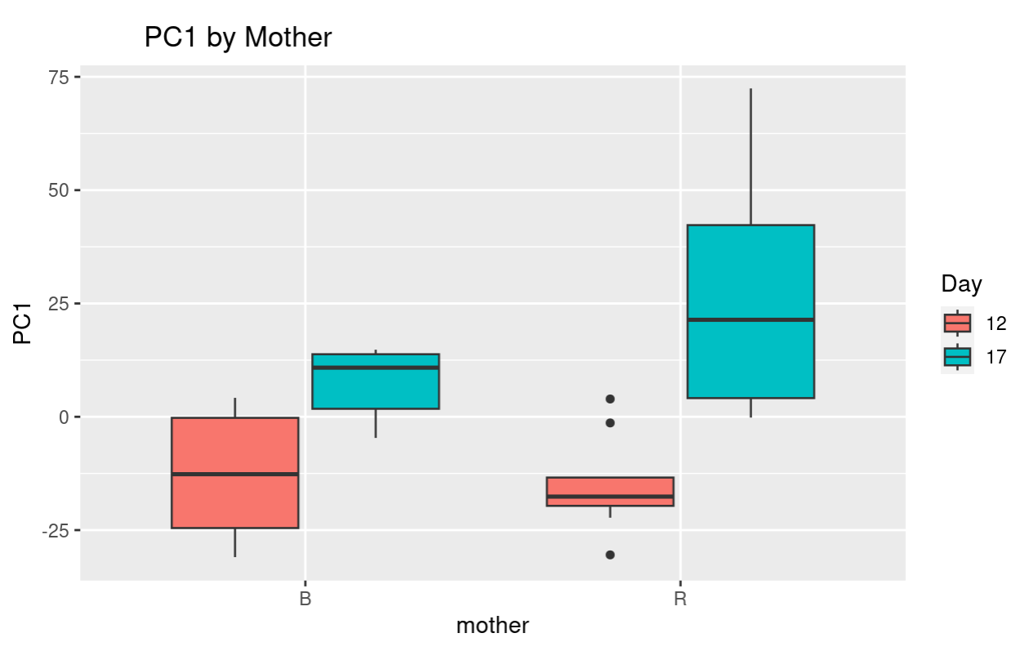
PC1 Score Boxplot by Mother
Analysis
For both mothers, fish in 12 dph have a lower score than fish in 17 dph.
Variation differences in PC1 scores
Significant variation when comparing days to respective mothers
Further Questions
Why is there variation between the PC1 scores for the dph, depending on the mother?

Slide 16
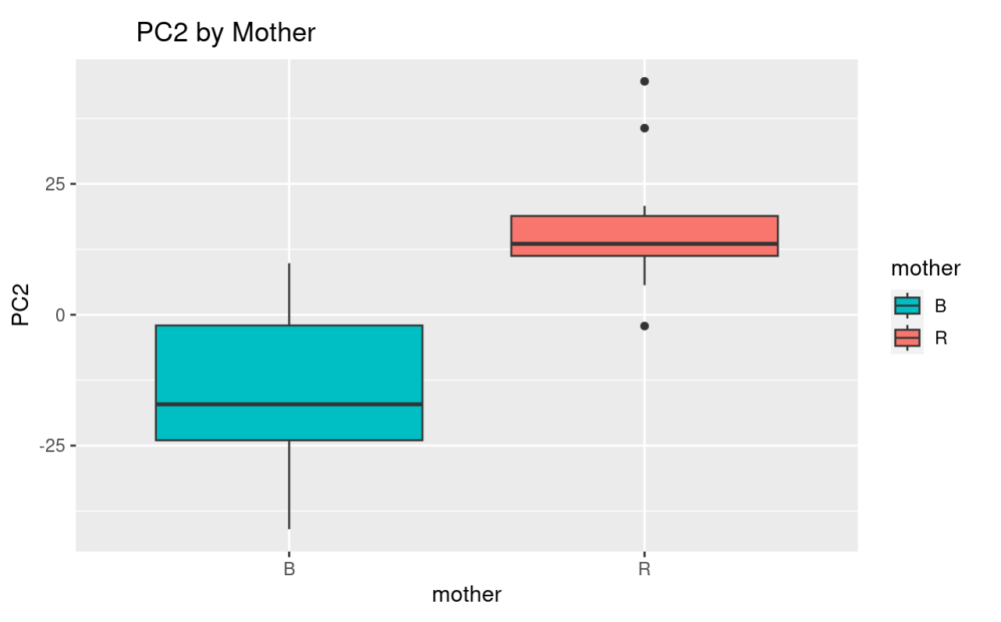
PC2 Score Boxplot by Mother
Feature Chosen by PC2
The mother accounts for ~9% of the total variation
Analysis
More Variation in the children of B than R
More Outliers in mother R
PCA Results after filtering by mother
Further Questions
Differences in genes expressed?

Slide 17
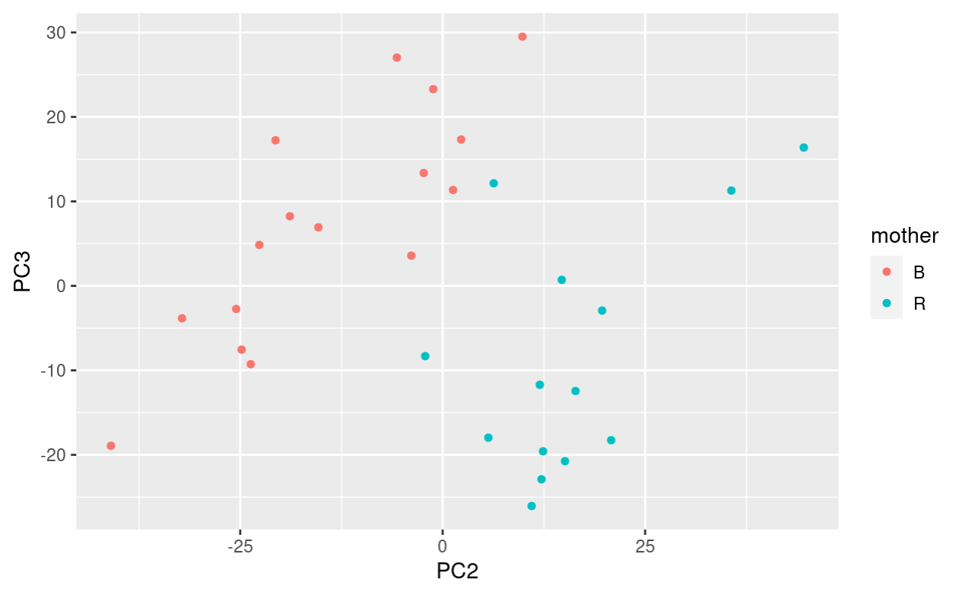

Slide 18
Our Findings
Identified genetic differences in Nile Tilapia based off of days post fertilization account for a significant amount of variance, with increase and less varied expression in 17 dph.
More overall variation in offspring of Mother B.
GO annotations to cross evaluate with highly annotated organisms
Identify specific molecular functional differences
Overlay on heatmap for better visualization
Notes:
(carolina) If able to continue with research, we would like to use GO annotations to cross evaluate with highly annotated organisms. This would allow us to identify the specific functional differences of the genes of younger Nile Tilapia and to overlay these functions on our heatmap for more digestible visualization.

Slide 19
Potential Implications and Final Thoughts
Aligns with exploration of how visual adaptations allow for mobile aquatic organisms to thrive.
Initial concern over low counts
Accounted for by p value difference in DESeq versus volcano plot
Still significant in broader picture
Exploring more questions
Why was there so much variation between PC1 & PC2 compared to rest of values?
Relationship between Danio rerio & Pan troglodytes & Nile Tilapia
How do these functions relate to the observed expression patterns and potential interactions with other genes?

Slide 20
Thank you!
Questions?

